Slide 1




Advancing a Social Europe for all
#SocialRights #UnionOfEquality

Slide 2

Employment
Social protection
and inclusion
EU’s Social Dimension
Social dialogue
Education and training

Slide 3
A Strong Social Europe is a top priority for EU citizens

Slide 4

9 in 10 Europeans consider
a Social Europe important
for them personally
54% believe there will be a more Social Europe by 2030
Source: Special Eurobarometer 546 on Social Europe - 2024

Slide 5
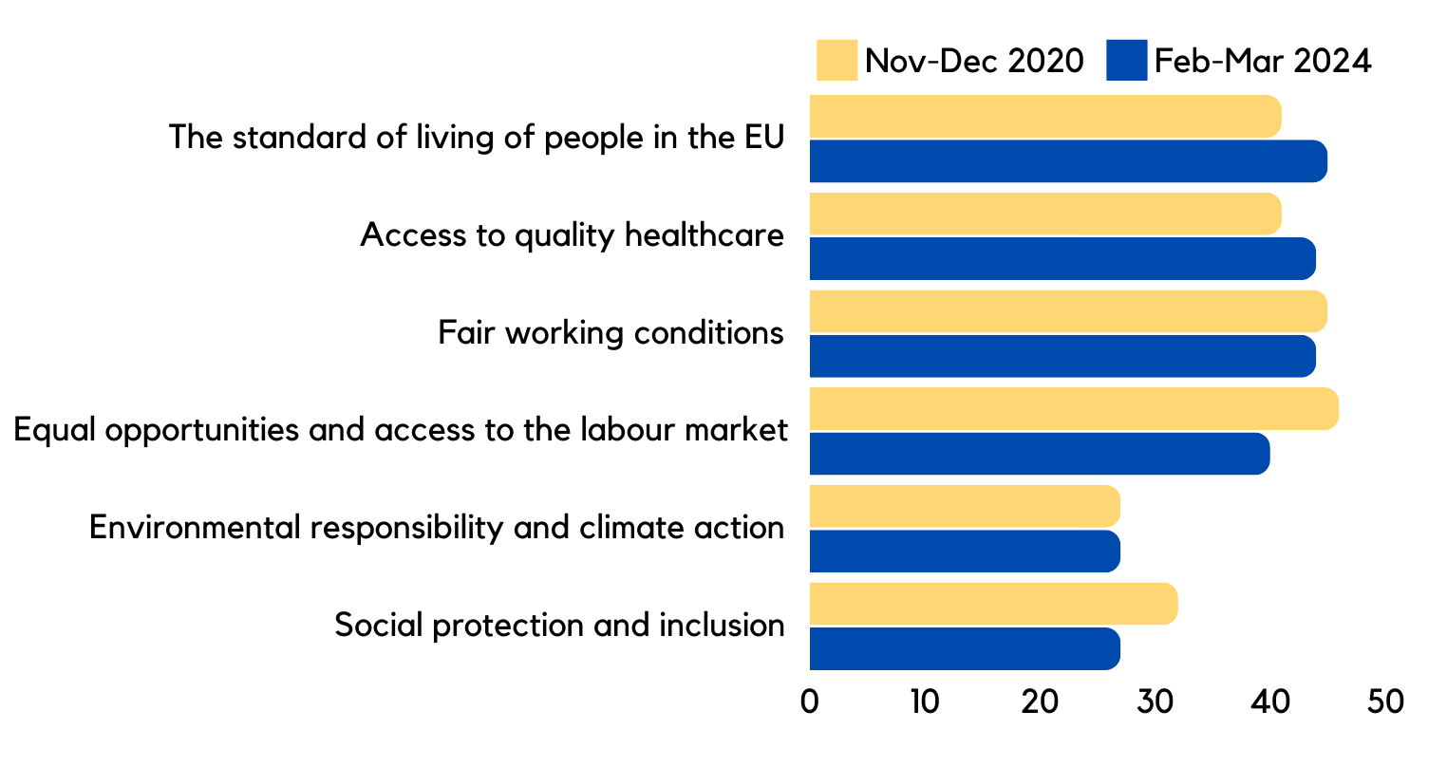
Key elements for EU’s social and economic development
45%
44%
44%
40%
27%
27%
Source: Special Eurobarometer 546 on Social Europe - 2024

Slide 6
DG Employment, Social Affairs and Inclusion
Our role and mission

Slide 7




Who are we?
The European Commission
46 Directorates-General
Ursula Von der Leyen
President
Roxana Mînzatu
Executive
Vice-President,
Social Rights and Skills, Quality Jobs and Preparedness

Slide 8





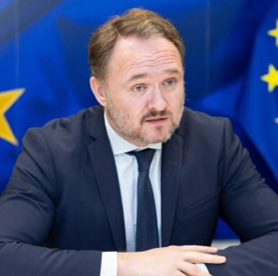


Who are we?
The European Commission
46 Directorates-General
Dan Jørgensen
Commissioner for Energy and Housing
Hadja Lahbib
Commissioner for Equality, Preparedness and Crisis Management
Dubravka Šuica
Commissioner for the Mediterranean
Glenn Micallef
Commissioner for Intergenerational Fairness, Youth, Culture and Sport

Slide 9


Who are we?
Directorate-General for Employment, Social Affairs and Inclusion
European Foundation for the Improvement
of Living and Working Conditions (Eurofound)
Brussels office
European Centre for the Development
of Vocational Training (CEDEFOP)
European Agency for Safety and Health at Work (OSHA)
European Training Foundation (ETF)
Director-General
Mario Nava
European Labour Authority (ELA)
Staff: 900 located in Brussels and Luxembourg
Labour market of 246 million people

Slide 10
What do we do? EU competence in social affairs
Article 3 of the Treaty
on the European Union
  Social Policy
Shared competence (Art.4 TFEU)
The Union shall (...) aim at full employment and social progress (...).
It shall combat social exclusion and discrimination, and shall promote
social justice and protection, equality between women and men, solidarity between generations and protection
of the rights of the child.
  Vocational training
Supporting competence (Art.5 TFEU)

Slide 11
What do we do? Social Policy
Shared competence (Art.4 TFEU)
Promoting employment
Equal treatment of workers
Social policy objectives
Adequate social protection
Social dialogue
Article 151 of the TFEU
Combating exclusion
Improving working and living conditions
Developing human resources aimed at achieving a high and sustainable level of employment

Slide 12
What do we do? Vocational training
Supporting competence (Art.5 TFEU)
Help workers adapt to industrial changes through vocational training and retraining
Enhance vocational training to support entry
and return to the labour market
  EU complements the action
  of the Member States
Facilitate access to vocational training
and encourage mobility
Article 166 of the TFEU
Stimulate cooperation on training
Facilitate information exchange between Member States

Slide 13

What do we do? EU Social Dimension Policy
Our Compass: the European Pillar of Social Rights with its Action Plan and 2030 targets
Policy coordination: European Semester and Social Scoreboard
Policy
European Social Fund Plus (ESF+)
Funds
European Globalisation Adjustment Fund for Displaced Workers
Working conditions
Free movement of workers
Future of work
Health and Safety at Work
Promoting inclusion and equality
Enforcement/infringements
Legislation
Social Dialogue

Slide 14




What do we do? The legislation
Worker’s rights
Free movement of workers
Health and Safety at Work
Working conditions
Social Dimension of the EU
Future of work
Right to disconnect and telework
Promoting inclusion and equality

Slide 15



What do we do?
Money supporting policies and reforms
Cohesion Fund
€42,6 billion for the period of 2021-2027. This fund aims to strengthen the Union's economic, social and territorial cohesion with a view to promoting sustainable development.
Over €2 billion per year for affordable housing and homelessness projects
Over €4 billion per year to alleviate poverty and social exclusion
Over €9 billion per year for helping people develop new skills for the modern job market
European Social Fund Plus (ESF+)*
*For the period of 2021-2027

Slide 16
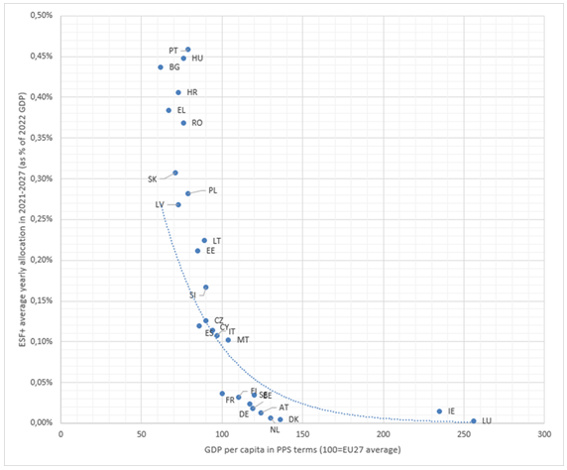
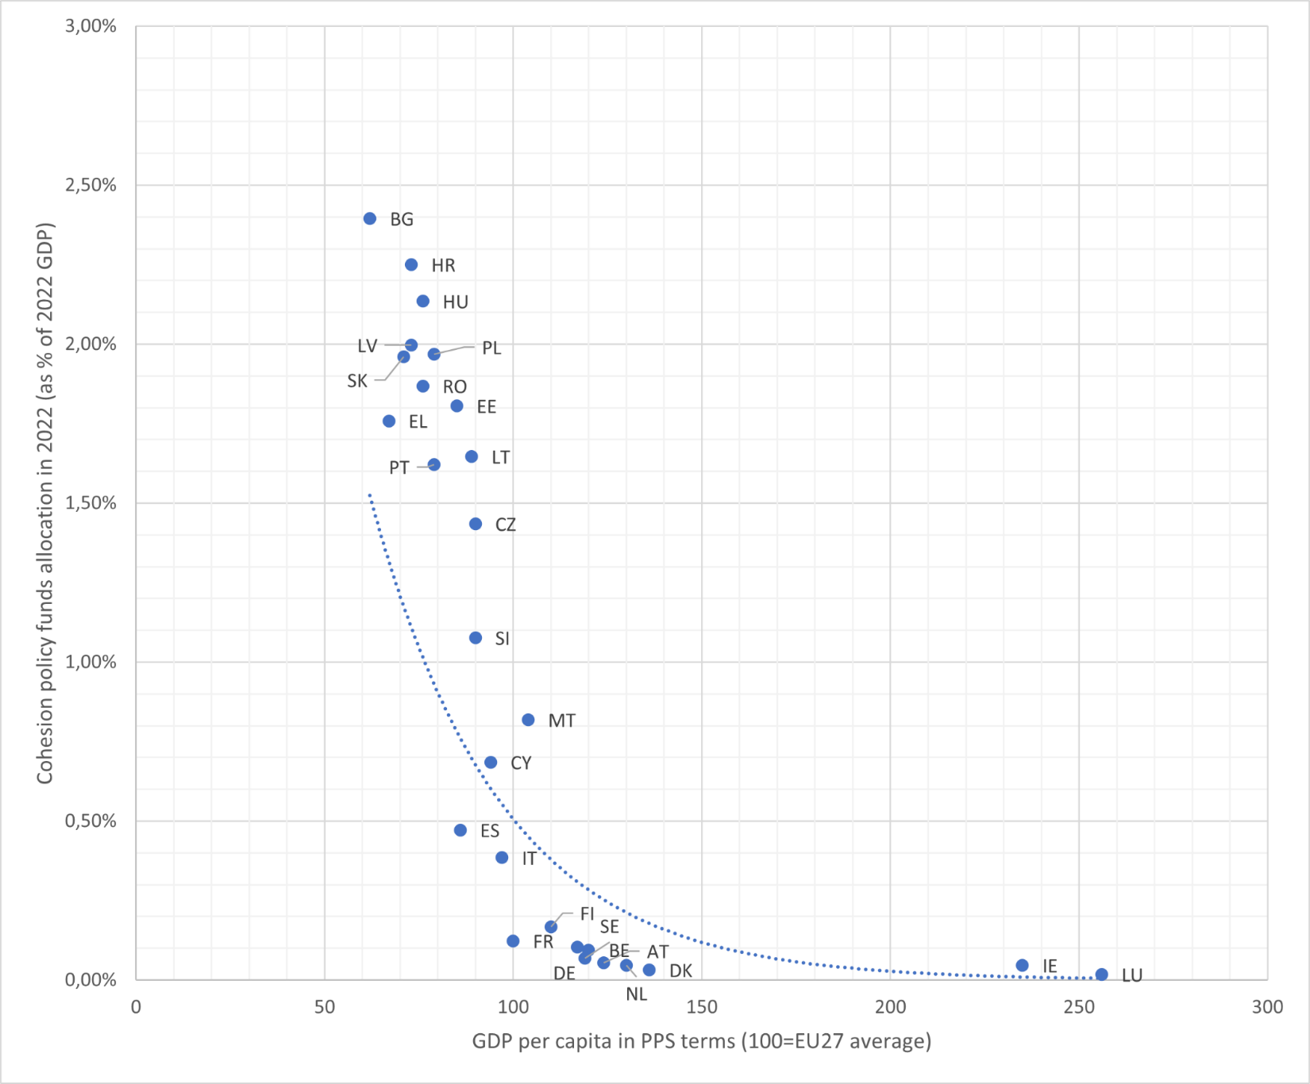
COUNTRIES and ESF+ & Cohesion Fund
These graphs illustrate the redistribution of EU funds to countries with less developed economies to support their development and reduce economic disparities within the EU (ESF+) and promote economic and social convergence within the EU (Cohesion Fund)
Notes:
Figure 1:
Countries with a lower GDP per capita (such as Bulgaria, Romania, Greece) receive a higher average annual ESF+ allocation as a percentage of their GDP
Countries with a higher GDP per capita (such as Luxembourg, Ireland, the Netherlands) receive a lower average annual ESF+ allocation as a percentage of their GDP.
This indicates a redistribution of funds towards countries with less developed economies to support their development and reduce economic disparities within the EU
Figure 2:
Countries with a lower GDP per capita (such as Latvia, Slovakia, Bulgaria) receive a higher allocation of cohesion policy funds as a percentage of their GDP
Countries with a higher GDP per capita (such as Luxembourg, Ireland, the Netherlands) receive a lower allocation of cohesion policy funds as a percentage of their GDP
This graph also shows a redistribution of cohesion funds towards countries with less developed economies to promote economic and social convergence within the EU

Slide 17


How we monitor progress and build recommendations
on economic and employment policies
European Semester
Social Scoreboard
Annual exercise for :
Monitors the implementation of the Pillar by tracking trends and performances across EU countries
Fiscal surveillance
Surveillance of macroeconomic policies
Coordination of EU countries’ economic
and employment policies

Slide 18

How we enforce the EU Social Acquis
Informal dialogue with Member States
Guardian of the Treaties
Infringement procedures
As a result of:
Administrative letters
Citizens’ complaints
Political letters
Commission’s own investigations
EU Pilots
Failure to notify national implementing measures transposing directives

Slide 19
European Pillar
of Social Rights

Slide 20
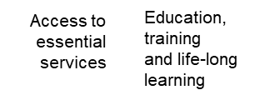
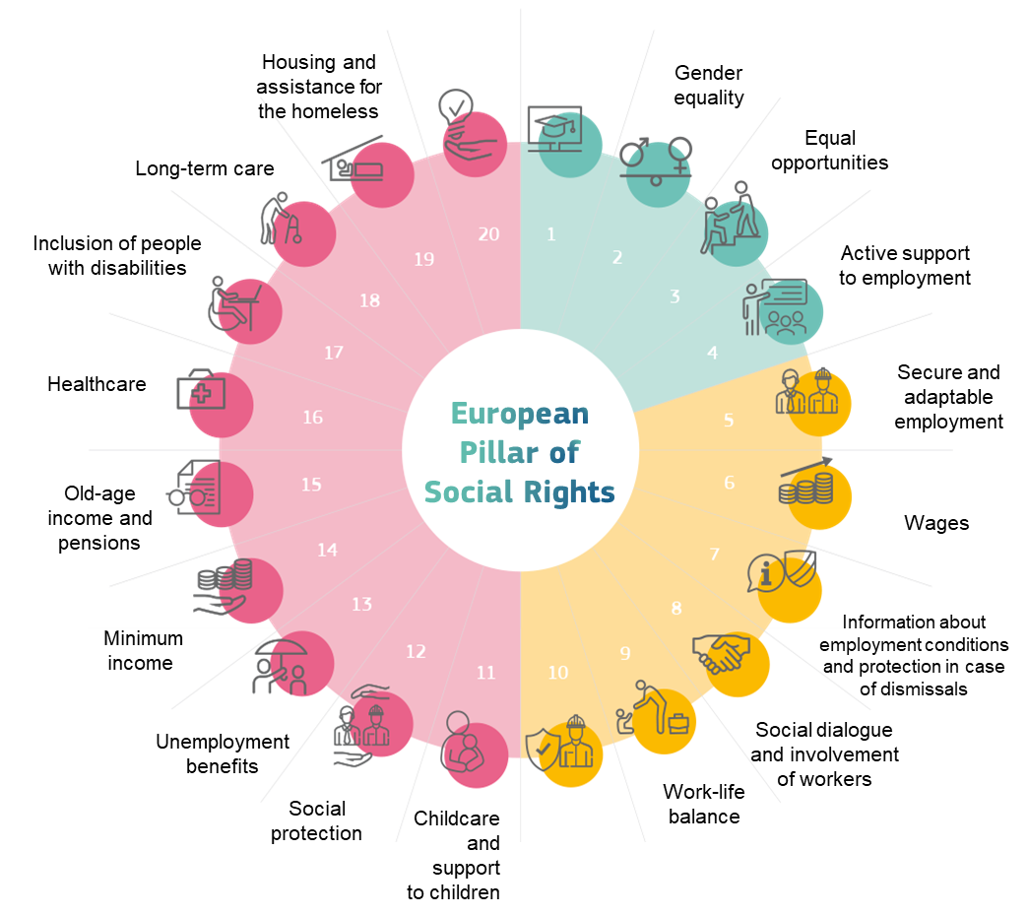

Our Compass
Equal opportunities and access to the labour market
Social protection and inclusion
Fair working
conditions

Slide 21
Timeline: Key dates
European Pillar
of Social Rights Action Plan
Presented by the European Commission
March
Action Plan 2.0
Review of the European Pillar of Social Rights
1957
1961
1989
1992
2000
2007
2017
2021
2022
2024
2025
European Social Charter
Fundamental social and economic rights for European citizens
October
European Pillar of Social Rights
Proclamation
Gothenburg Declaration
November
Porto Declaration
Porto Social Summit
Headline targets for 2030
May
La Hulpe Declaration On the Future of the European Pillar of Social Rights for the period 2024-2029
April

Slide 22
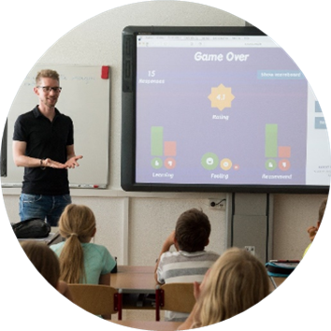

Implementing the Pillar: the Action Plan
More and better jobs
Skills and equality
Social protection and inclusion

Slide 23



Headline Targets for 2030
2021
2021
At least
78%
2030
At least
60%
2030
At least
15 million*
of the population aged 20 to 64 should be in employment by 2030
Current level: 75.3% (2023)
of all adults should participate
in training every year by 2030
Current level: 39.5% (2022)
fewer people at risk of poverty
or social exclusion by 2030
Current level: -1.6 million
*at least 5 million of them should be children
Current level: +0.6 million

Slide 24
Key achievements
Equal opportunities and access
to the labour market
Fair working conditions
Social protection
and inclusion
Temporary Support to Mitigate Unemployment Risks in an Emergency (SURE)
Directive on Platform Work
European Child Guarantee
Directive on Work-Life Balance
Strategy for the Rights
of Persons with Disabilities 2021-2030
Reinforced Youth Guarantee
Directive on Adequate Minimum Wages
Directive on Quality Traineeships
European Disability Card
Updated Carcinogens, Mutagens and Reprotoxic substances Directive (CRMD)
Pact for Skills
LGBTIQ Equality Strategy
European Care Strategy
Recommendation on strengthening Social Dialogue
European Platform on Combating Homelessness
Right to disconnect

Slide 25


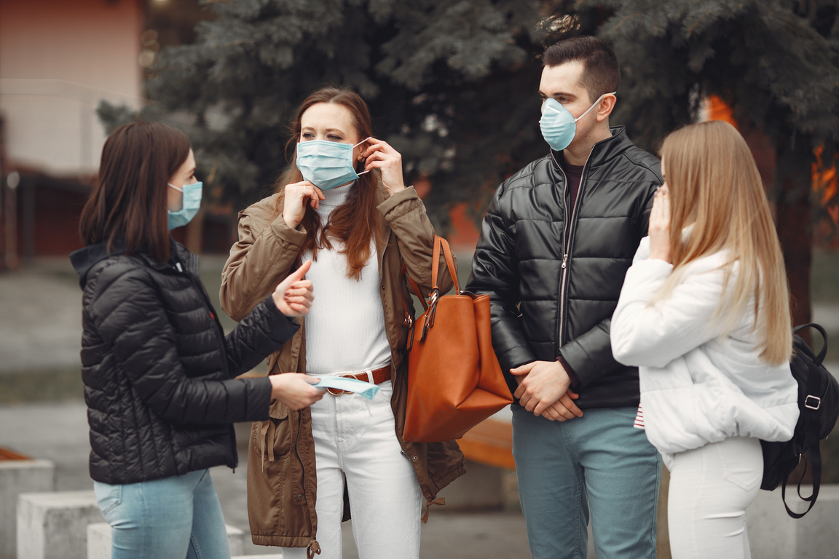
Key achievements
50 million
young people in Youth Guarantee secured jobs, apprenticeships, traineeships, or continued education
and training
40.5 million
workers and 3.3 million companies helped in 2020-2021 via SURE. €98.4 billion provided to help 19 Member States
3.5 million
people received training through the Pact for Skills in 2022 and 2023

Slide 26
Looking ahead: the Future of Social Europe

Slide 27
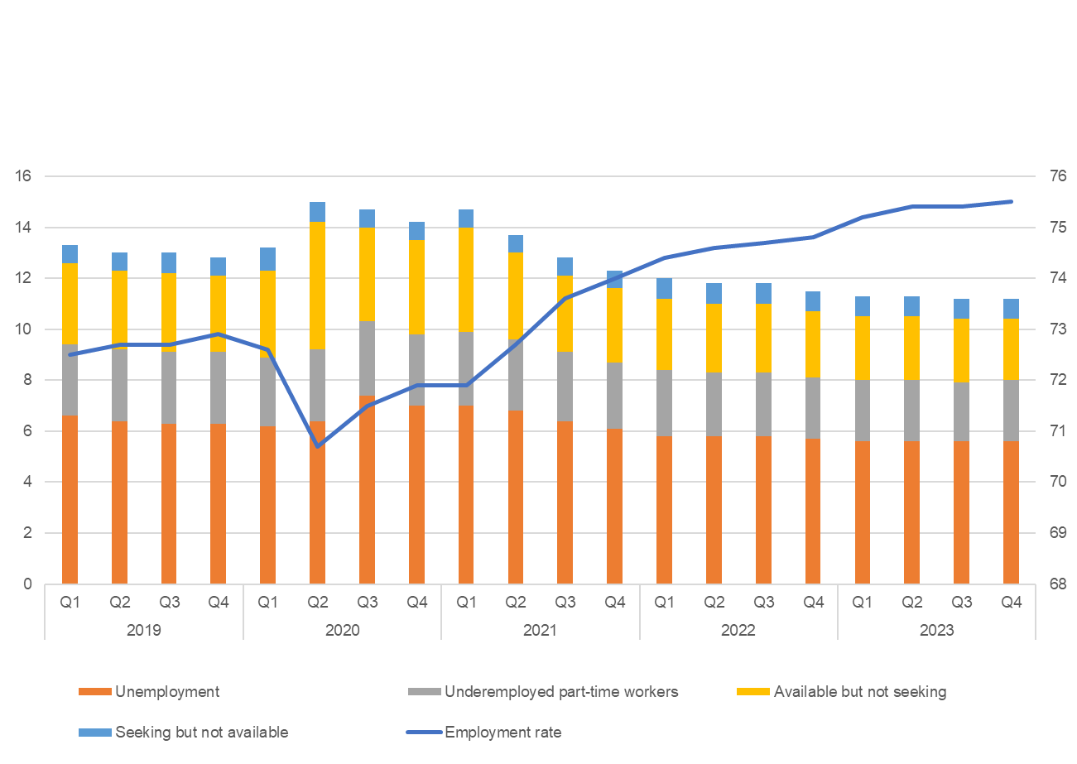
Record high employment rate in the EU in 2023
75.4% employment rate for people aged 20-64

Slide 28
Achieving social targets for 2030:
Coordinate efforts and mobilize resources to meet the set targets
Basic and STEM skills:
Bridging gaps in basic and STEM skills to meet labor market needs
Skills development:
Ensuring a coherent and inclusive approach to skills development across Europe
Working conditions for teachers:
Improving working conditions, training, and career prospects for teachers
Vocational training:
Increasing the number of people with secondary vocational education diplomas
Implementation of European funds:
Ensuring effective use of funds to support social rights and a fair transition
Combating poverty:
Addressing the root causes of poverty and ensuring access to essential protections
Challenges and initiatives
Roxana Mînzatu’s Mission Letter
Coordination of social security:
Modernizing and simplifying the coordination of social security to meet current needs
Legal migration:
Attracting talent to meet labor market needs while managing integration challenges
Recognition of qualifications:
Facilitating the recognition of skills and qualifications across EU countries
Strengthening social dialogue in times of change:
Adapting social dialogue mechanisms to new economic and social realities
Long-term care workforce:
Recognizing skills, career progression, and improving working conditions in the long-term care sector
Health and safety at work:
Improving health and safety standards, including mental health at work
Labor mobility:
Facilitating mobility while ensuring compliance with rules and workers' rights
Impact of digitalization on work:
Managing the effects of digitalization and algorithms on working conditions and workers' rights

Slide 29




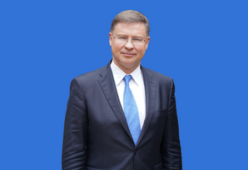
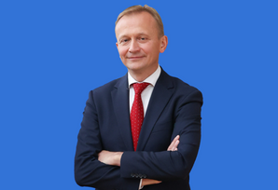






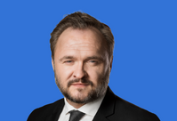




Enlargement
Migration and labour shortages
Competitiveness
Digital transition
Climate change
In the context of …
Artificial Intelligence
Housing affordability
Green transition
Poverty and inclusion
Geopolitical tensions
Aging population
Security
Rule of law

Slide 30



Key challenges
Competitiveness
EU competitiveness gap vis-a-vis US and China is widening
By 2040, the workforce is projected to shrink by 2 million workers each year

Slide 31


Key challenges
Labour and skills shortages
74% of EU SMEs say they face skills shortages
90% of jobs demand digital skills, but only 56% Europeans have basic proficiency

Slide 32


Key challenges
Poverty and inclusion
95 million people
in the EU are at risk
of poverty or social exclusion (21.7% of
the population)​
Around 20% of unemployed people at risk of poverty are not eligible to receive any income support

Slide 33


Key challenges
Artificial Intelligence
Algorithmic Management in the workplace
As of 2022, up to 28% of European companies may have been using technology solutions and/or AI tools to support recruiting and hiring efforts
A survey from 2019 shows that 12% of EU companies had implemented machines for employee management or surveillance

Slide 34
Thank you!

